Slide 1
A Brief Intro to Computers
Luís A. Nunes Amaral

Slide 2
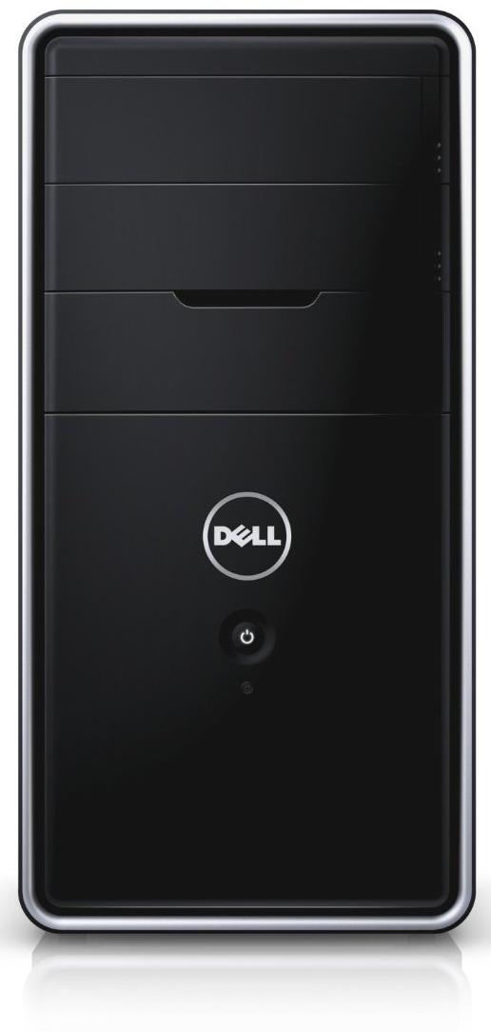
Helping my son
Dell Inspiron 3000
Processor 3.2 GHz Intel Core i5
Bus 64-bit
RAM 8 GB DDR3 1600MHz
Hard Drive 1 TB SATA
Hard Drive Rotational Speed 7200 RPM
Optical Drive Type DVD-RW
Number of USB 2.0 Ports 4
Number of USB 3.0 Ports 2
Audio-out Ports (#) 1
Operating System Windows 7 Home Premium

Slide 3
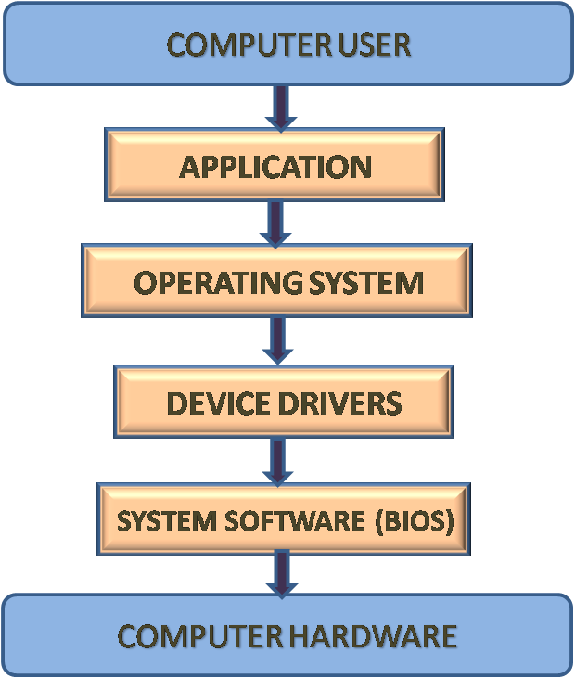
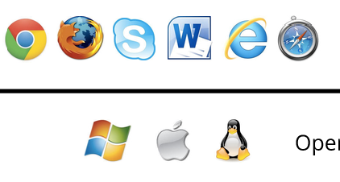
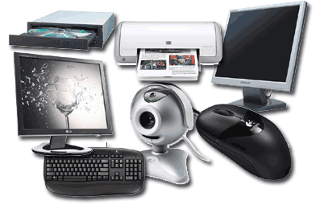
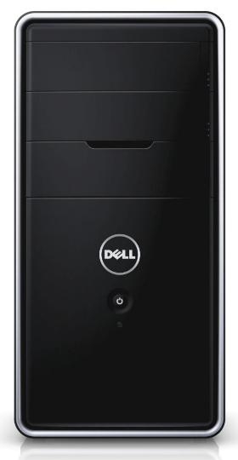
Using a computer

Slide 4
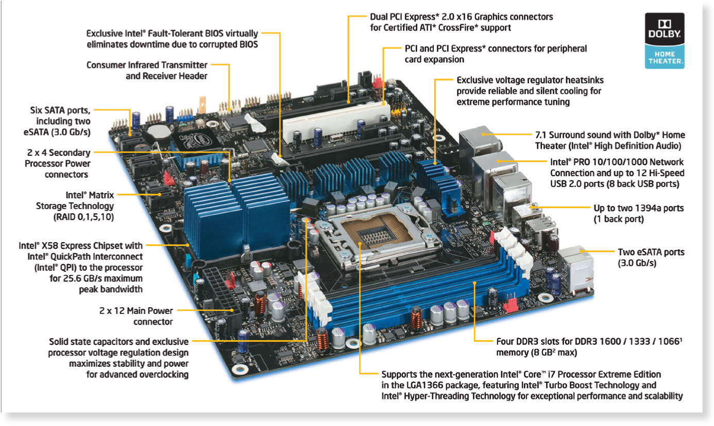
The hardware

Slide 5
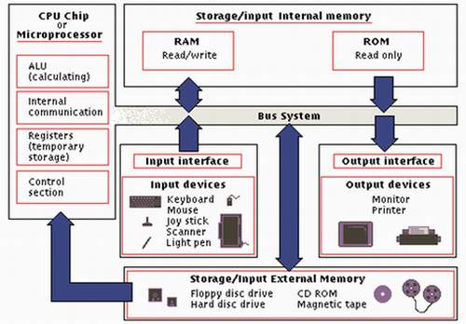
The hardware, simplified

Slide 6
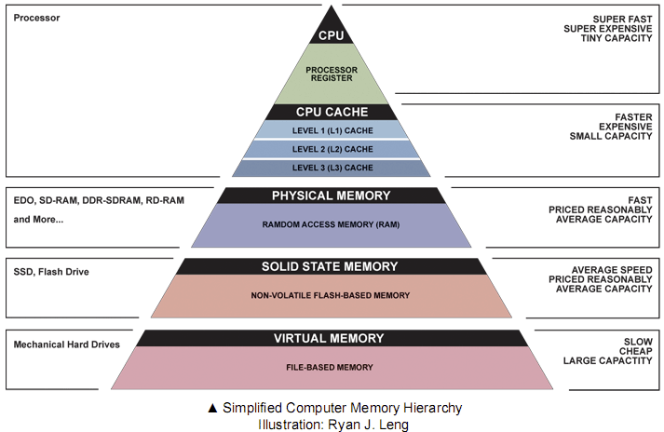
Why memory and storage
Vanishes on power off
Remains on power off

Slide 7
Memory and storage
Dell Inspiron 3000
Processor 3.2 GHz Intel Core i5
Bus 64-bit
RAM 8 GB DDR3 1600MHz
Hard Drive 1 TB SATA
Hard Drive Rotational Speed 7200 RPM
Optical Drive Type DVD-RW
Number of USB 2.0 Ports 4
Number of USB 3.0 Ports 2
Audio-out Ports (#) 1
Operating System Windows 7 Home Premium

Slide 8
Bits, bytes, and beyond
Bit = Binary digit; Byte = Binary word
Name | Abbr. | Value
bit | b
byte (or octet) | B | 8 bits | 1 B | 2⁰ B
kilobyte | kB | 1024 B | 1 024 B | 2¹⁰ B
megabyte | MB | 1024 kB | 1 048 576 B | 2²⁰ B
gigabyte | GB | 1024 MB | 1 073 741 824 B | 2³⁰ B
terabyte | TB | 1024 GB | 1 099 511 627 776 B | 2⁴⁰ B
petabyte | PB | 1024 TB | 1 125 899 906 842 624 B | 2⁵⁰ B

Slide 9
How fast does the clock tick?
Dell Inspiron 3000
Processor 3.2 GHz Intel Core i5
Bus 64-bit
RAM 8 GB DDR3 1600MHz
Hard Drive 1 TB SATA
Hard Drive Rotational Speed 7200 RPM
Optical Drive Type DVD-RW
Number of USB 2.0 Ports 4
Number of USB 3.0 Ports 2
Audio-out Ports (#) 1
Operating System Windows 7 Home Premium

Slide 10
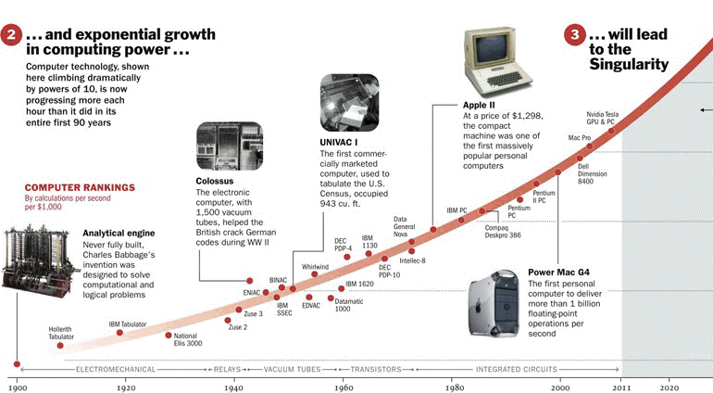
How far we have gone

Slide 11
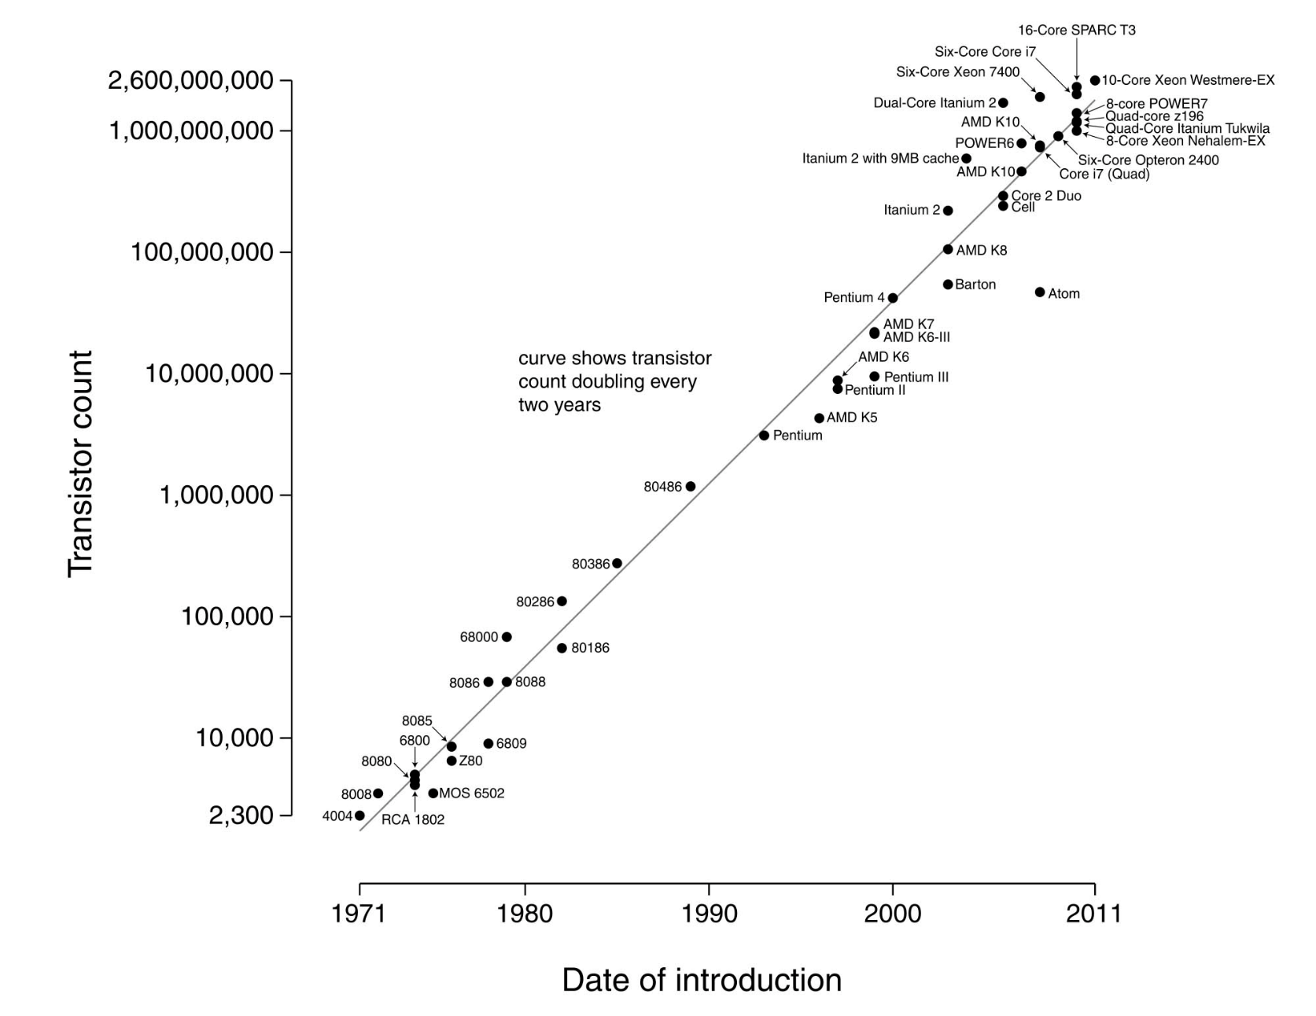
How far we have gone

Slide 12
How far we have gone

Slide 13
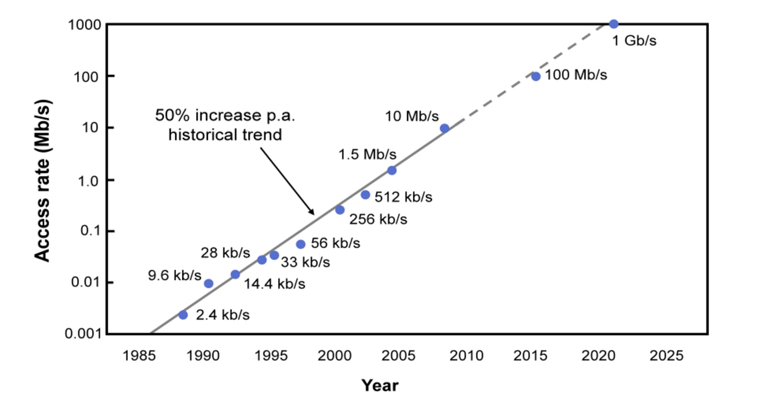
How far we have gone

Slide 14
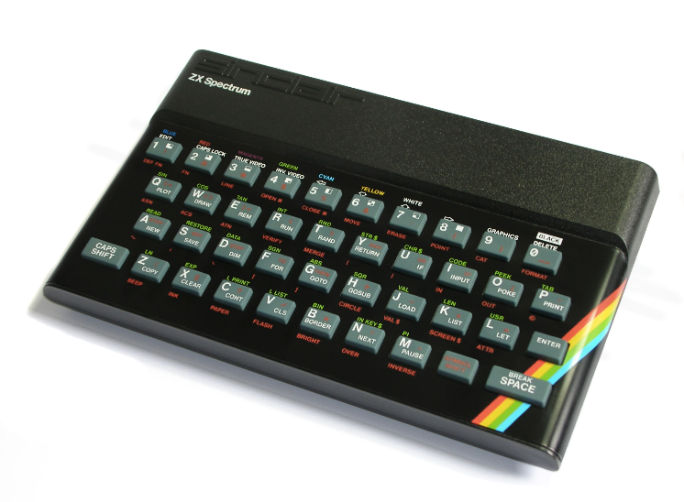
Sinclair ZX Spectrum (1982)
Processor 3.5 MHz Zilog Z80A
Bus 8-bit
ROM 16 KB
RAM 16-48 KB
Video Controller 32x24 text, 256x192 graphics (8 colors)
Hard Drive None
Data Transfer Cassette
Operating System Sinclair BASIC in ROM
Price £125 (approx. $600 in today’s dollars)

Slide 15
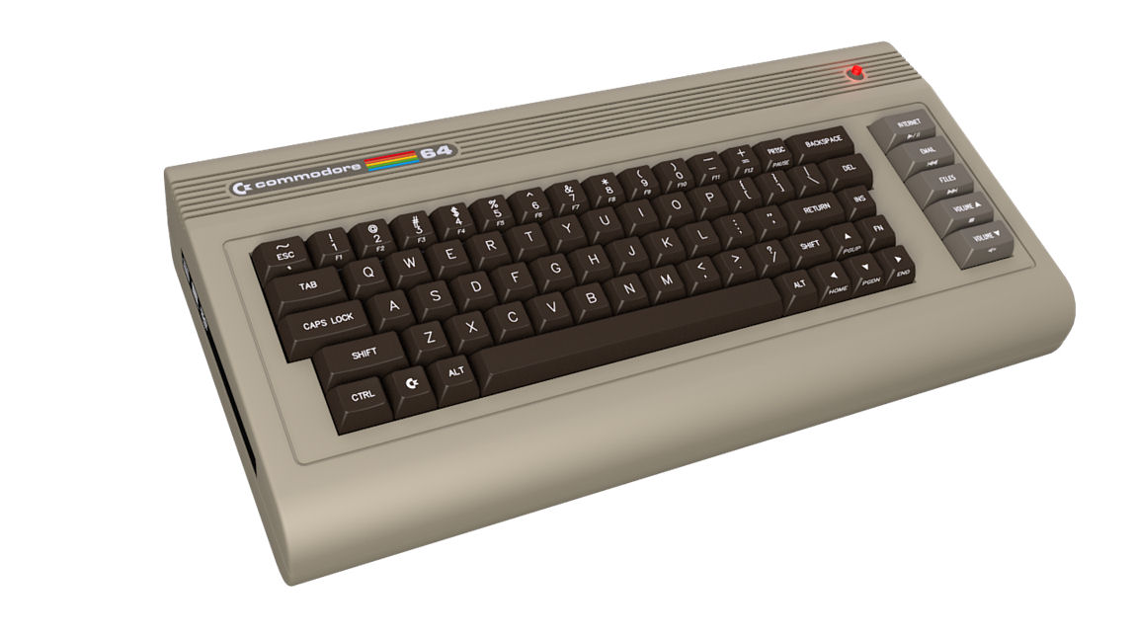
Commodore 64 (1982)
Processor 1.023 MHz MOS Technology 6510
Bus 8-bit
ROM 20 KB
RAM 64 KB
Video Controller 40x25 text, 320x200 graphics (16 colors)
Hard Drive None
Data Input Cassette, 170 KB floppy disk
Operating System Commodore BASIC 2.0 in ROM
Price $600 (approx. $1500 in today’s dollars)

Slide 16
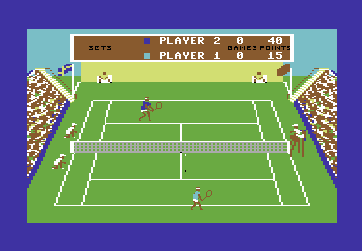
What people did

Slide 17
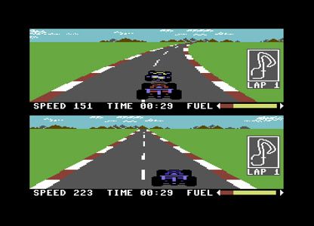
What people did

Slide 18
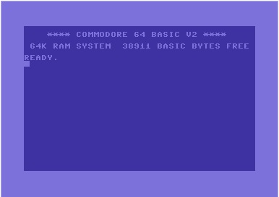
What people did
10 PRINT "Hello, I'm the Commodore 64 - What is your name ";:INPUT A$
20 PRINT "Hello " A$
30 END

Slide 19
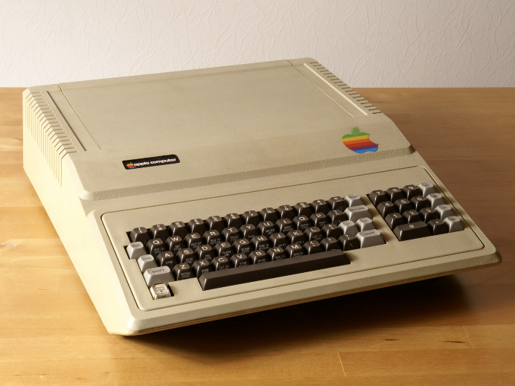
Apple II (1977)
Processor 1.0 MHz MOS Technology 6502
Bus 8-bit
ROM
RAM 4-48 KB
Video Controller 40x24 text, 280x190 graphics (6 colors)
Hard Drive None
Data Transfer Cassette, 134 KB Floppy disks
Operating System Woz Integer BASIC in ROM
Price $1,298 (approx. $5,000 in today’s dollars)

Slide 20
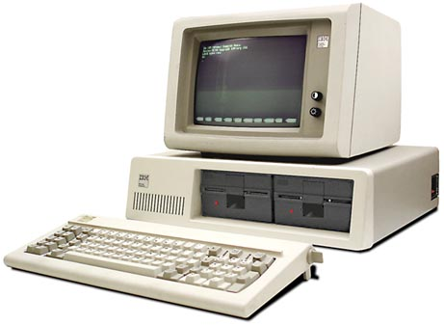
IBM PC 5150 (1981)
Processor 4.7 MHz Intel 8088
Bus 8-bit
RAM 16-256 KB
Video Controller 80x24 text
Hard Drive None
Data Transfer Cassette, 160 KB floppy drives
Operating System CP/M86, PC DOS 1.0 (IBM + MSFT)
Price $1,565

Slide 21
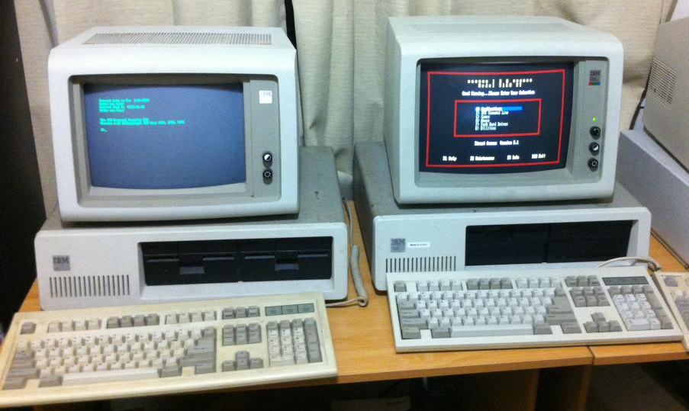
IBM PC XT (1983)
Processor 4.7 MHz Intel 8088 + 8087 (Math Processor)
Bus 8-bit
RAM 128-640 KB
Video Controller EGA 640x350 with 64 colors
Graphics Card ROM 16 KB
Hard Drive 10 MB
Operating System PC DOS 2.0 (IBM + MSFT)

Slide 22
Writing your own applications

Slide 23
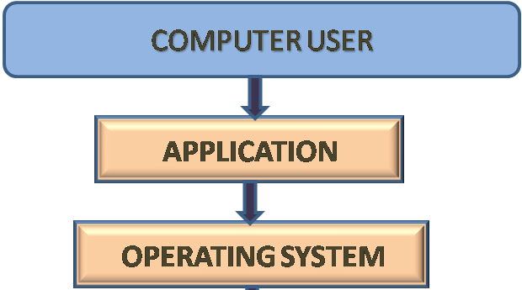
Writing your own applications
Need to understand:
Computer/cloud storage capabilities
Internal/external data transfer capabilities
Location of software and data

Slide 24
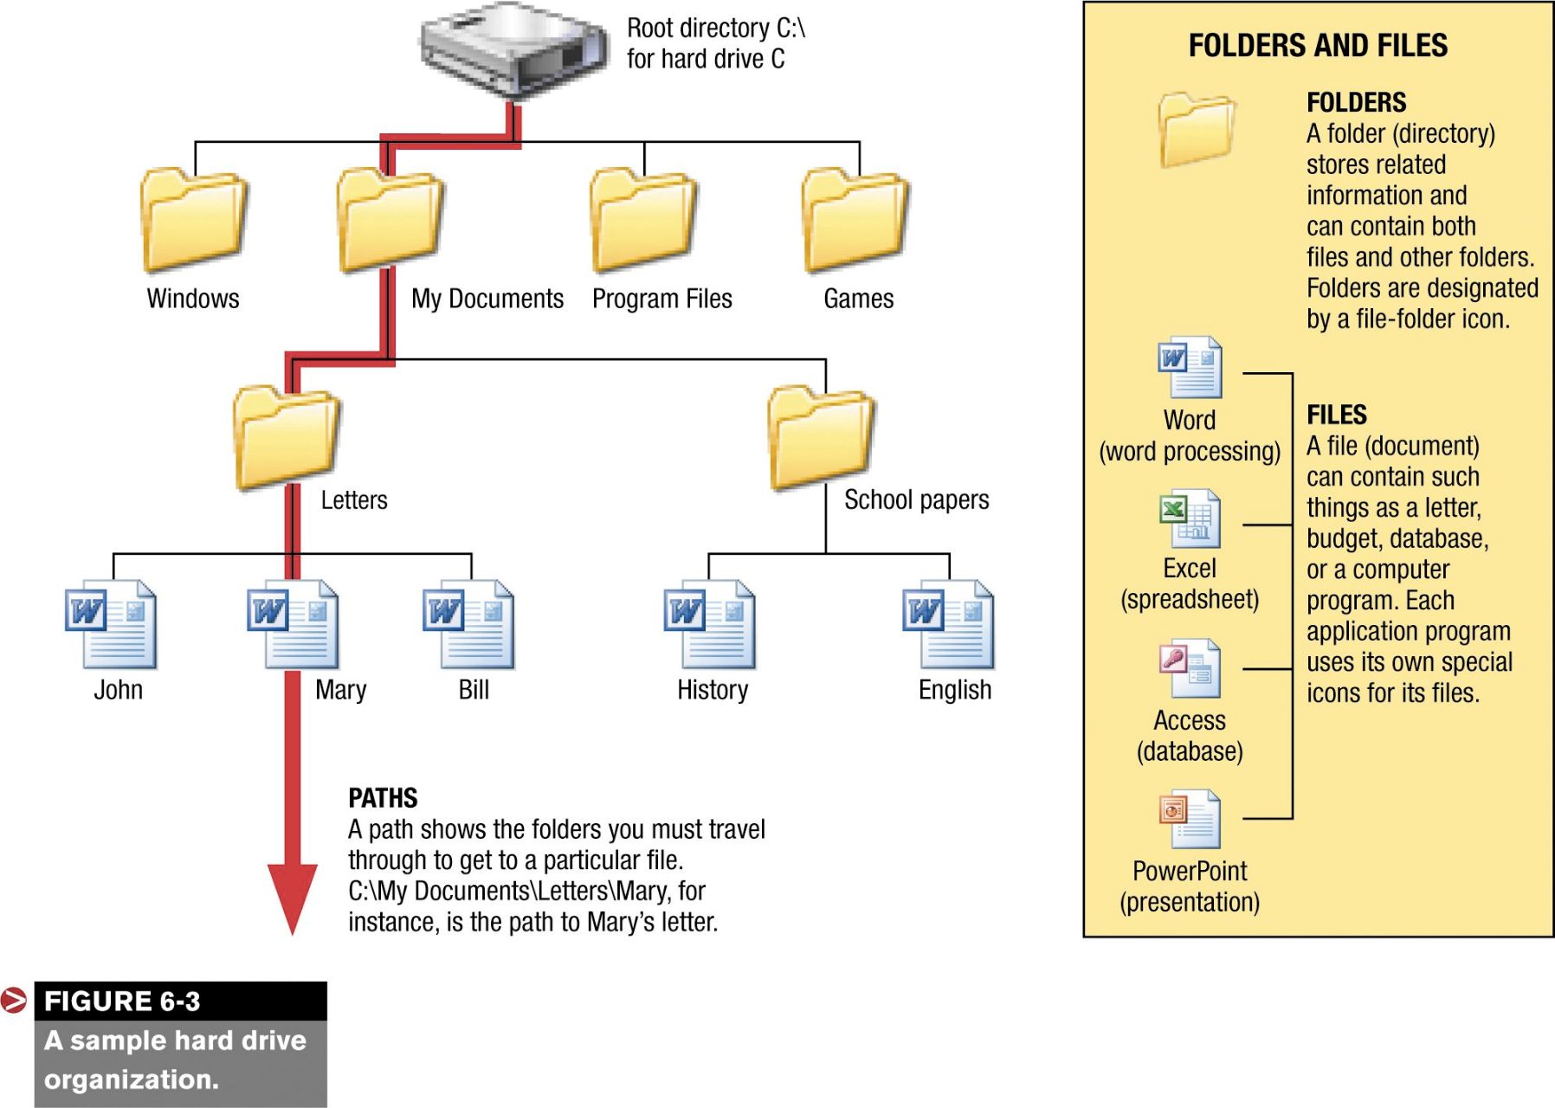
Mount points, folders, and so on

Slide 25
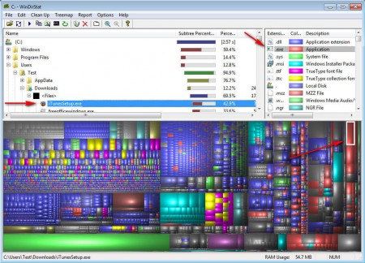
Mount points, folders, and so on

Slide 26
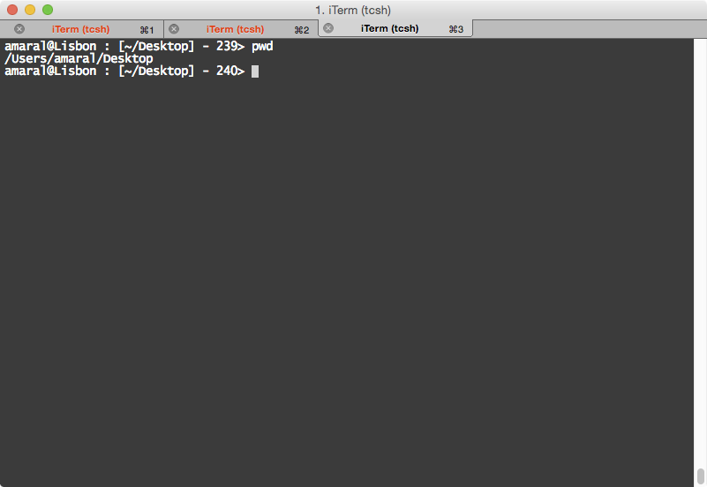
Unix is more transparent

Slide 27
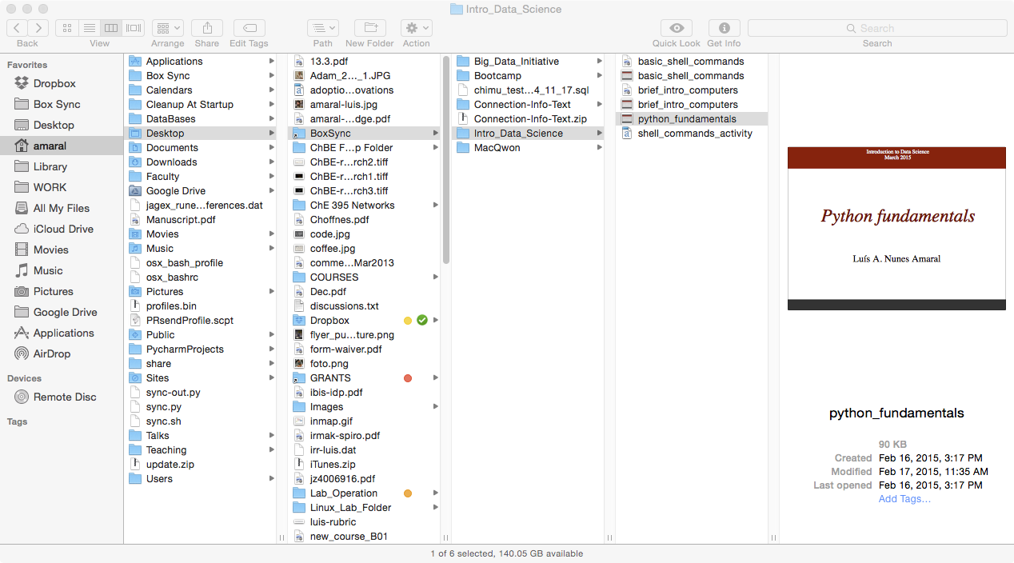
Mac OS X filesystem

Slide 28
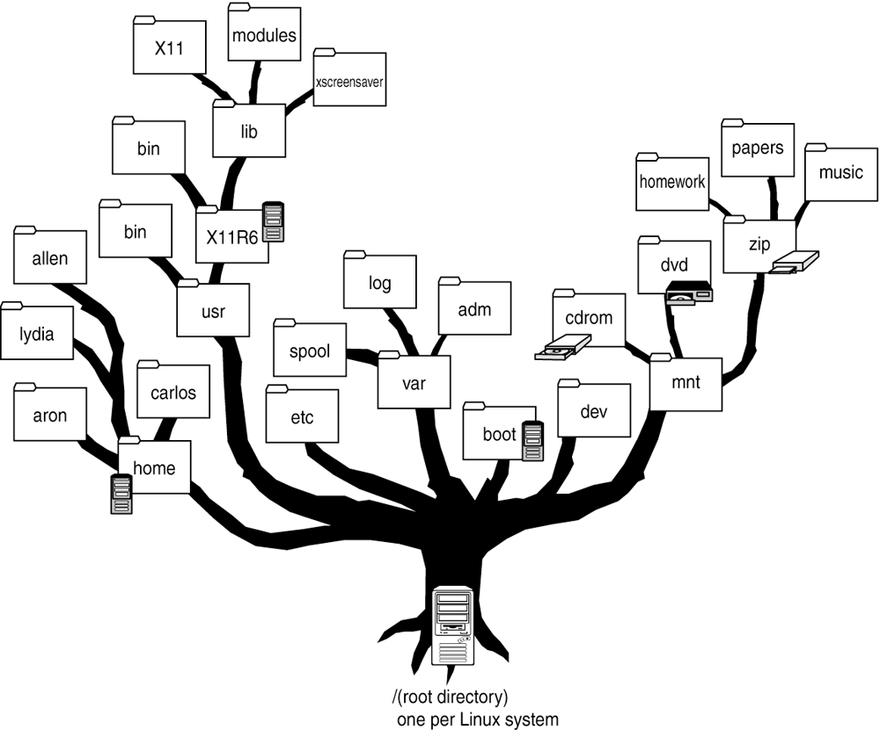
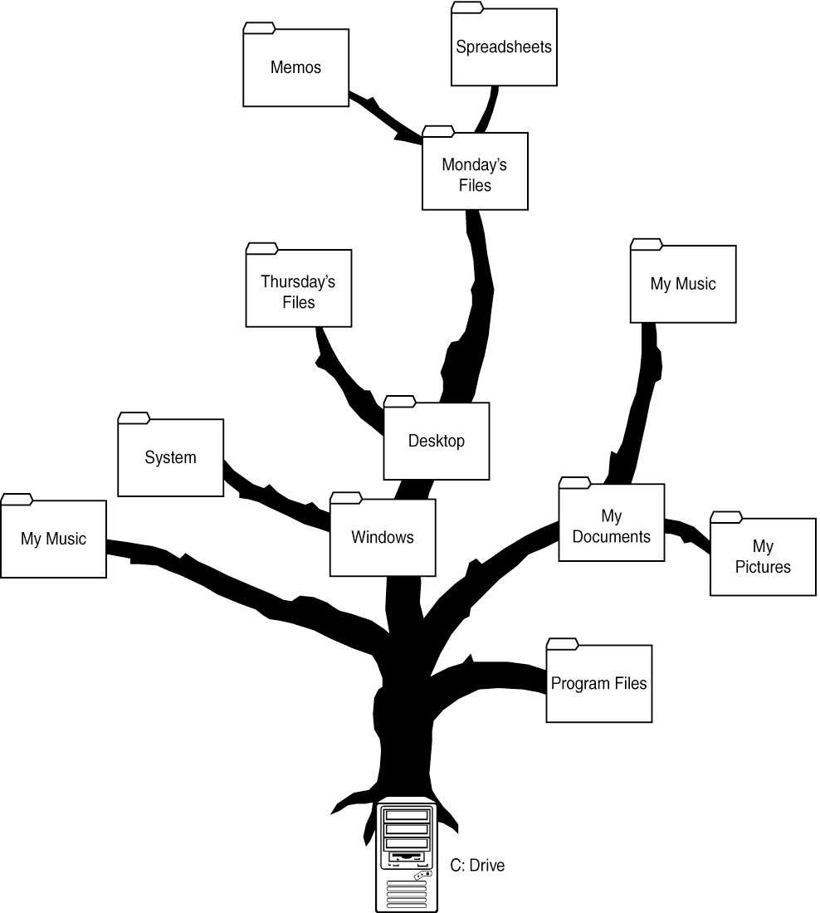
Filesystems are trees

